Slide 1
Fundamental of Programming
Lecture # 01
Hammad Ali Shah
Department of Computer Science
City University of Sciences and Information Technology,
CUSIT Peshawar.

Slide 2
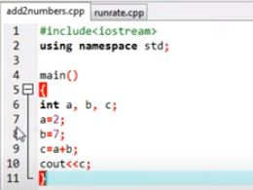
What is Programming?
A sequence of instructions to perform a task
Tool to Communicate with computer

Slide 3
What is Computer Language?
A "computer language," also known as a programming language, is a formal system used to communicate with computer.

Slide 4
Why do we study Computer Language?
Software
Computer
Develop by Human
Computer Language

Slide 6
Machine language
Only language computer directly understands
Defined by hardware design
Machine-dependent
Generally consist of strings of numbers
Ultimately 0s and 1s
Instruct computers to perform elementary operations
One at a time
Example:
+1300042774 +1400593419 +1200274027

Slide 7
Assembly language
English-like abbreviations representing elementary computer operations
Clearer to humans
Incomprehensible to computers
Translator programs (assemblers)
Convert to machine language
Example:
LOAD BASEPAY ADD OVERPAY STORE GROSSPAY

Slide 8
High-level languages
Similar to everyday English, use common mathematical notations
Single statements accomplish substantial tasks
Assembly language requires many instructions to accomplish simple tasks
Translator programs (compilers)
Convert to machine language
Interpreter programs
Directly execute high-level language programs
Example:
grossPay = basePay + overTimePay

Slide 9
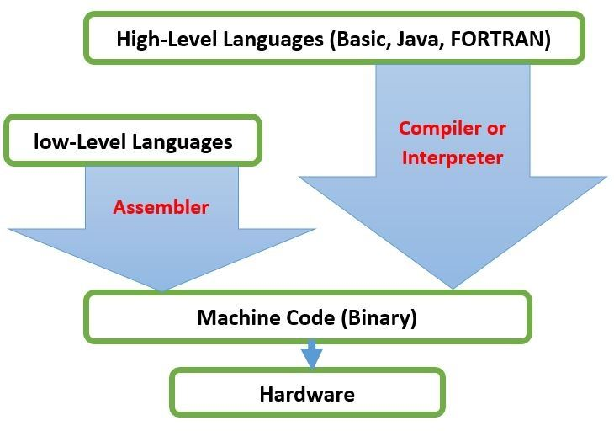

Slide 11
Basics of a Typical C++ Environment
Editor
Program is created in
the editor and stored
on disk.
Disk
Phases of C++ Programs:
Edit
Preprocess
Compile
Link
Load
Execute
Preprocessor
Disk
Preprocessor program
processes the code.
Compiler creates
object code and stores
it on disk.
Compiler
Disk
Linker links the object
code with the libraries,
creates an executable file and stores it on disk
Linker
Disk
Primary
Memory
Loader
Loader puts program
in memory.
Disk
.
.
.
.
.
.
Primary
Memory
CPU
CPU takes each
instruction and
executes it, possibly
storing new data
values as the program
executes.
.
.
.
.
.
.

Slide 12
What is C++?
C++ is a cross-platform language that can be used to create high-performance applications.
C++ was developed by Bjarne Stroustrup, as an extension to the C language.
C++ gives programmers a high level of control over system resources and memory.
The language was updated 4 major times in 2011, 2014, 2017, and 2020 to C++11, C++14, C++17, C++20.

Slide 13
Why Use C++?
C++ is one of the world's most popular programming languages.
C++ can be found in today's operating systems, Graphical User Interfaces, and embedded systems.
C++ is an object-oriented programming language which gives a clear structure to programs and allows code to be reused, lowering development costs.
C++ is portable and can be used to develop applications that can be adapted to multiple platforms.
C++ is fun and easy to learn!
As C++ is close to C, C# and Java, it makes it easy for programmers to switch to C++ or vice versa.

Slide 14
Difference between C and C++
C++ was developed as an extension of C, and both languages have almost the same syntax.
The main difference between C and C++ is that C++ support classes and objects, while C does not.

Slide 15
C++ Get Started
To start using C++, you need two things:
A text editor, like Notepad, to write C++ code
A compiler, like GCC, to translate the C++ code into a language that the computer will understand
There are many text editors and compilers to choose from. In this course, we will use an IDE

Slide 16
C++ Install IDE
An IDE (Integrated Development Environment) is used to edit AND compile the code.
Popular IDE's include Code::Blocks, Eclipse, and Visual Studio. These are all free, and they can be used to both edit and debug C++ code.
Note: Web-based IDE's can work as well, but functionality is limited.

Slide 17
Let's create our first C++ file.
#include <iostream> using namespace std; int main() { cout << "Hello World!"; return 0; }

